Slide 1

Banks in Distress
Analyzing the REGIONS of US Bank Failures

Slide 2
Goals
Where did bank failures occur?
Explain major bank failure events
Where does failure happen the most?
How much did the worst failures cost the federal government?
Can we predict when it will happen again?

Slide 3
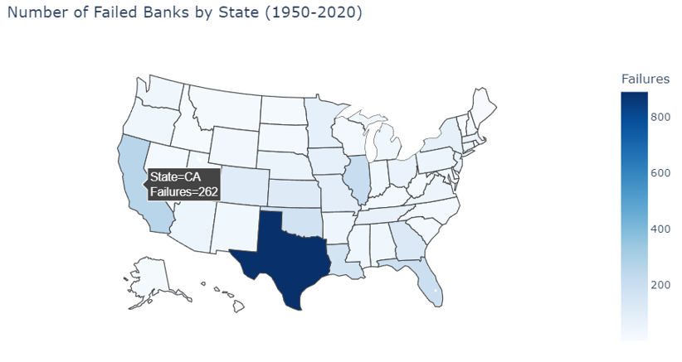
This is an interactive map that shows how many failed banks are in each state when they are hovered over. The darker the blue the more bank failures are in each state.

Slide 4
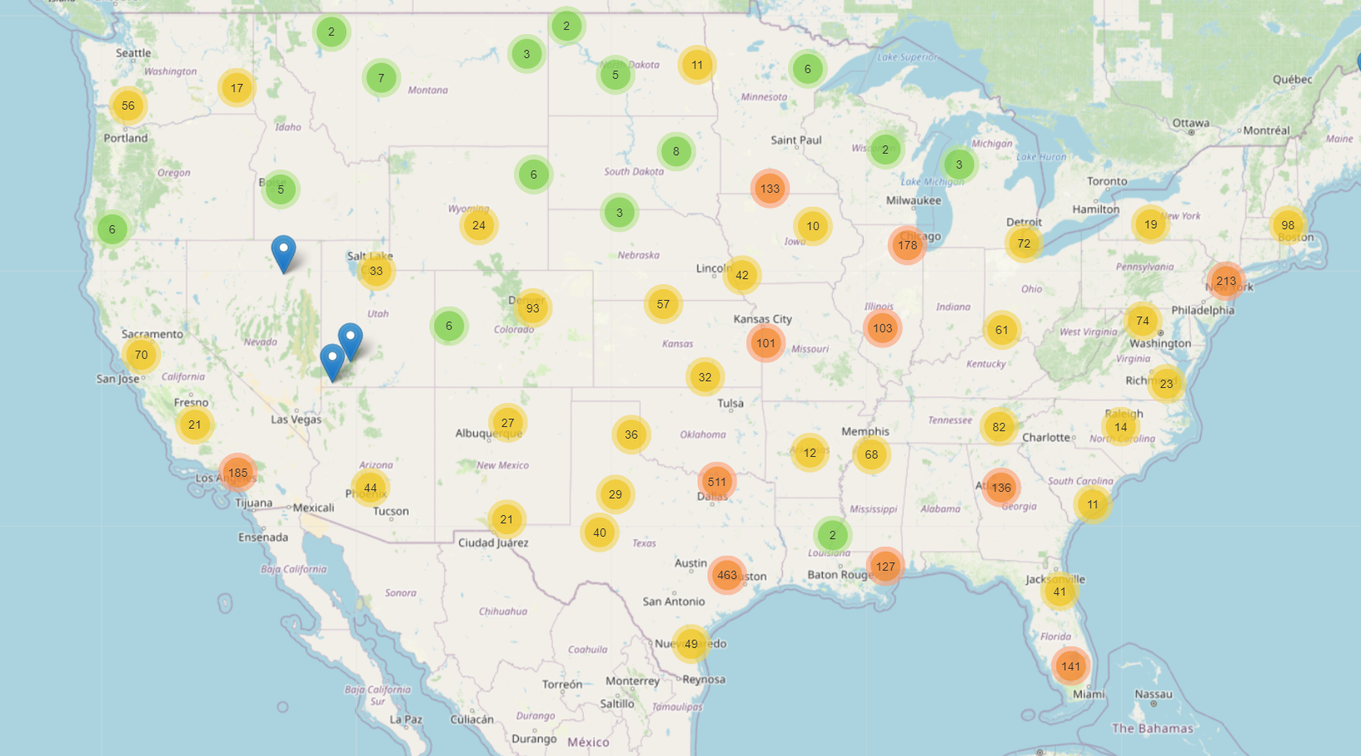
1950-2020
This shows all bank failures from 1950 to 2020 with their general locations

Slide 5
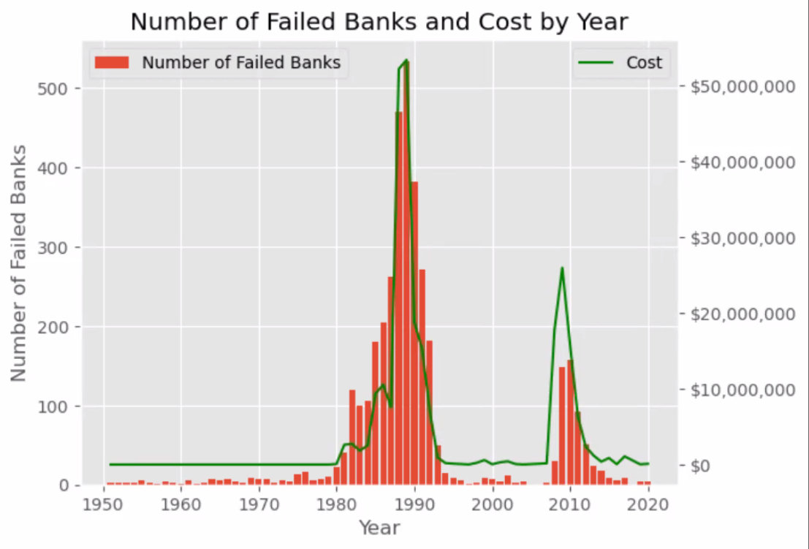
Years with major increases in bank failures
First major spike
High interest rates and inflation
Texas invested heavily in the oil boom, and when oil prices crashed hundreds of banks went under.
Next major spike
Housing market crash
Housing prices were on the rise
banks continued to lend and people
could not make their payments.

Slide 6
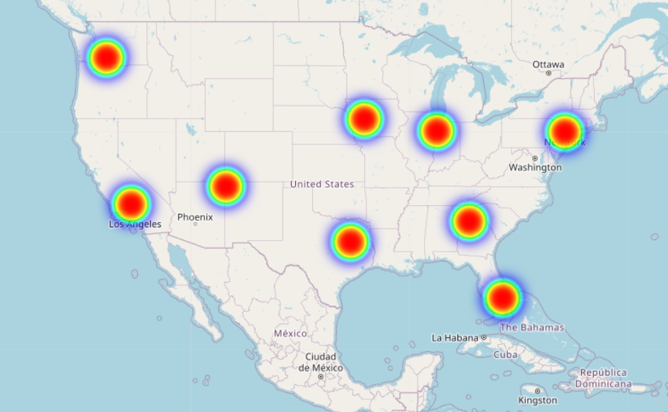
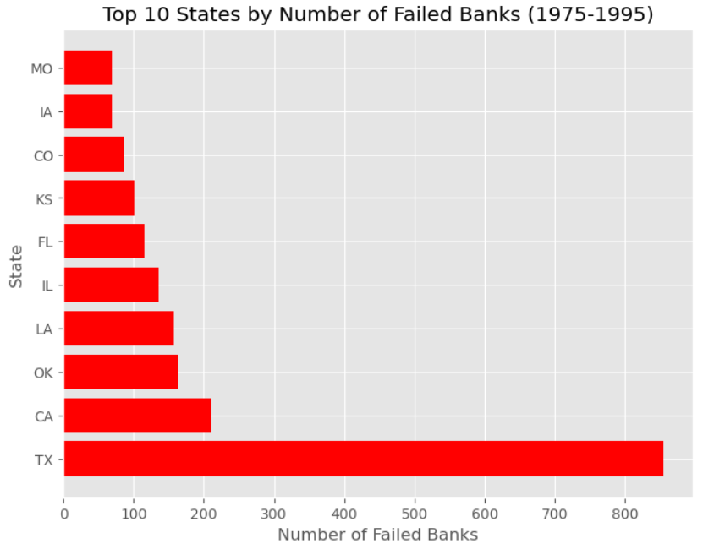
1975-1995
The Graph on the left shows the most concentrated areas with the most bank failures
The chart on the right shows the top ten states with the most failed banks

Slide 7
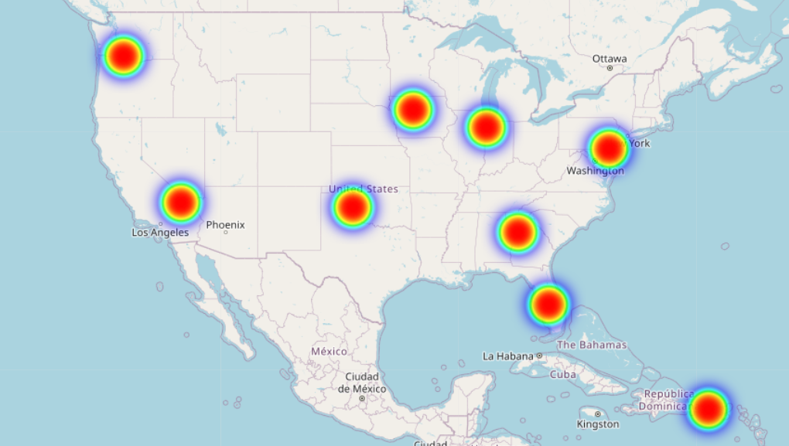
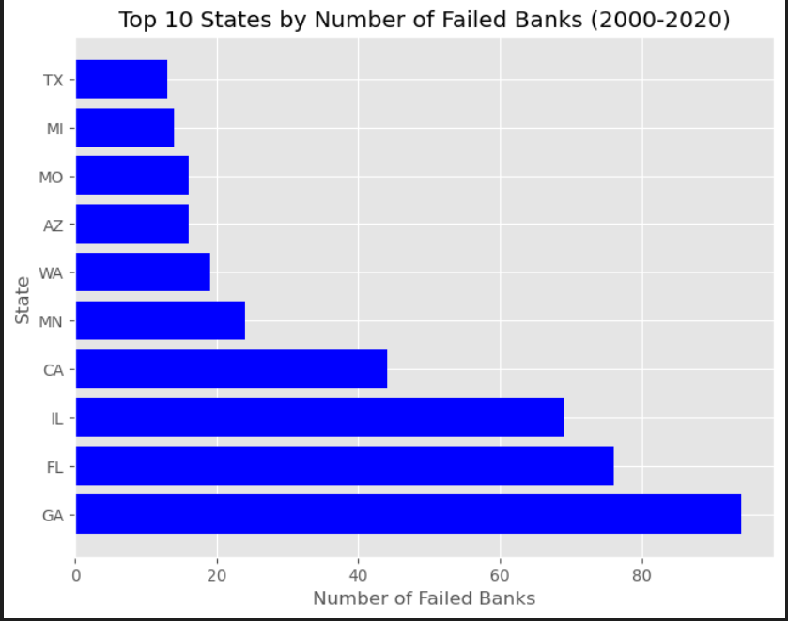
2000-2020
The Graph on the left shows the most concentrated areas with the most bank failures
The chart on the right shows the top ten states with the most failed banks

Slide 8
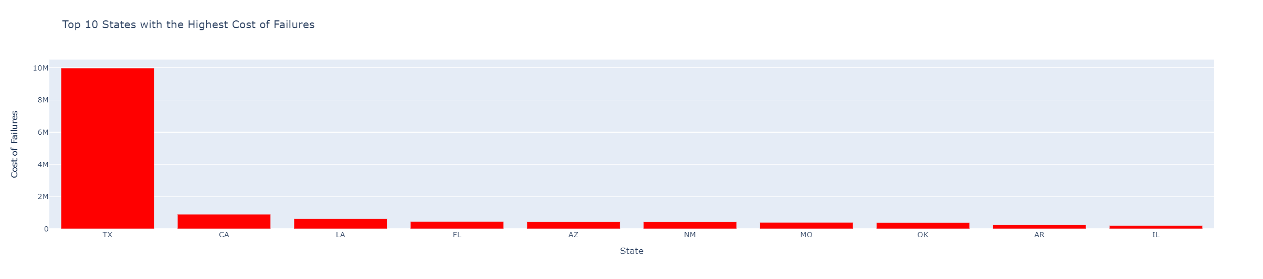
Highest cost failure (Assets couldn’t cover)

Slide 9
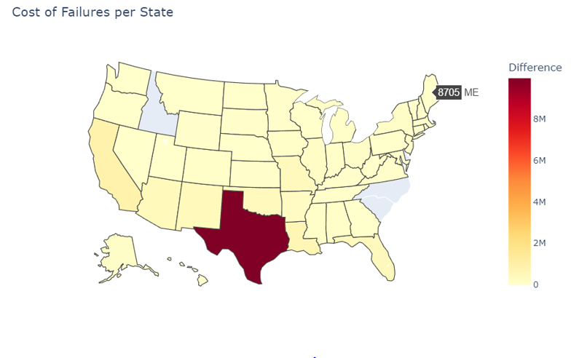
Interactive map with cost of failures
The Darker the color the higher the cost per state
Can hover over each state and it will tell you what is cost the government in USD
Gray states cost nothing
Texas cost the most by a large margin

Slide 10
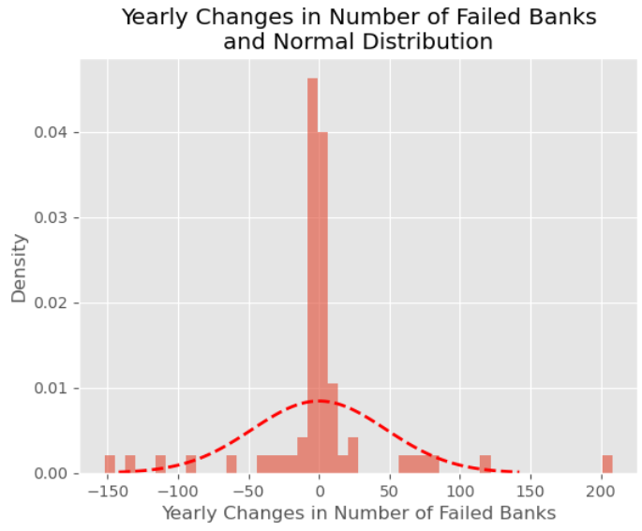
Uses average of change year-over-year to predict indicators of economic downturn If there is a spike of 15 more banks that failed compared to last year likely to be more
Attempting to find indicators of economic change

Slide 11
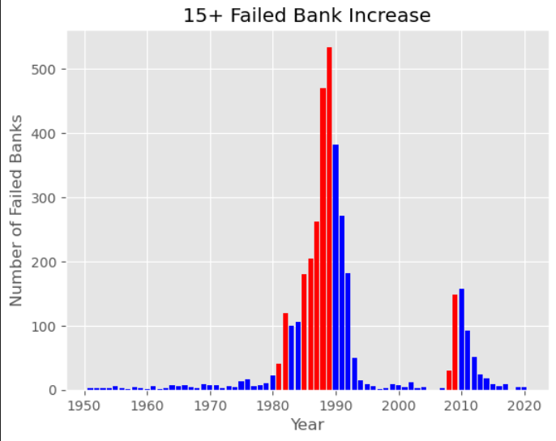
Red is minimum 15 failed bank increase year over year The red lines indicate that there may be a couple years of increased bank failures.
Prediction visual

Slide 12
Conclusion
Bank failures occurred more in the south and densely populated areas
The oil crash in the 1980s and the current housing crisis is the cause of most bank failures
How much did the worst failures cost the federal government?
Texas cost the government the most by a large margin at 10 million
Using our data we concluded when you see a year with an increase of 15 or more bank closures it is a good indication that more are a come

Slide 13

Thank you!

